Slide 1
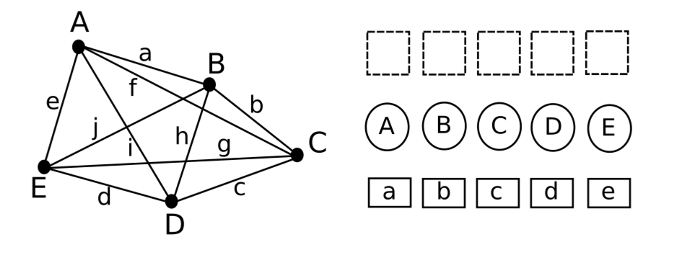
Computational Representation of TSP

Slide 2



An ant-like optimization strategy
Require heuristic for which city to add next
Need cost function that encodes length of a solution
Add pheromones according to (2) to each tour
Repeat all of the above

Slide 3
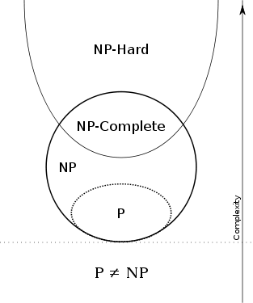
NP Completeness
Boolean satisfiability problem (SAT)
Knapsack problem
Hamiltonian path problem
Travelling salesman problem (decision version)
Subgraph isomorphism problem
Subset sum problem
Clique problem
Vertex cover problem
Independent set problem
Dominating set problem
Graph coloring problem
One problem can be reduced to another in polynomial time.

Slide 4
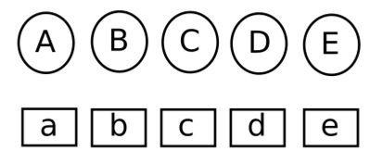

The quadratic assignment problem
List of M locations and distances between them (d: MxM matrix)
List of M facilities and flows between them (w: MxM matrix)
Find optimal assignment of facilities to locations to minimize
Given the distances of one location to all others, as well as the flows coming in to all facilities, what could be a good heuristic to solve the QAP?

Slide 5
A heuristic for the QAP
Sum of all distances to a node: “distance potential”
Sum of all flows into a facility: “flow potential”
Goal: assign facilities with high flow potential to nodes with low distance potential and the other way round

Slide 6
An Ant-based algorithm for the QAP
Use heuristic (distance potential times flow potential) to assign a facility to a node, starting with lowest distance potential
Calculate cost of solution
Assign pheromones to solution components
Repeat all of the above

Slide 7
The ACO meta-heuristic
Requirement: solution can be broken down in solution components
Quality of a solution is expressed by artificial pheromones that can be associated with each solution component
Incremental construction of solution is probabilistic and relies on
Problem-specific heuristic
Pheromone trail
Pheromones evaporate to prune poor solutions
Local search is used to improve solutions

Slide 8
Some useful ACO tricks
MIN-MAX values for pheromone trails
Elitist ants - only best ant can deploy pheromones
Local search

Slide 9
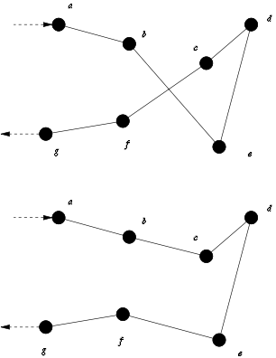
Local search
Generate better solutions by “swapping” solution components
2-opt local search, 3-opt local search
Massive improvement over ACO alone

Slide 10
Summary
The Ant-Colony Optimization meta-heuristic allows you to construct solutions that self-organize into a pattern that is close to the optimal one. Its ingredients are:
A heuristic which allows to rank order assignments. In the TSP, these are distances to cities, in the QAP these are distance and flow potentials. (Positive feedback)
A global cost function that can evaluate complete solutions and can be used to deposit pheromones on solution components as a function of their contribution.
A probabilistic rule that combines both the heuristic from (1) and past performance information from (2). This rule is usually parameterized, which allows to balance between exploration (from 2) and exploitation (from 1). (Randomness)
The ability to prune solutions over time using pheromone evaporation. (Negative Feedback)
Repeating 1-4 as often as necessary until a good-enough solution is found. (Multiple interactions)

